Slide 1
Data Structures Workshop
Day 2

Slide 2
Workshop Outline Today
Basic File I/O
Quick recap on what ArgumentManager.h is and how to use it for your homework assignments
FileZilla & PuTTY
Recursion

Slide 3
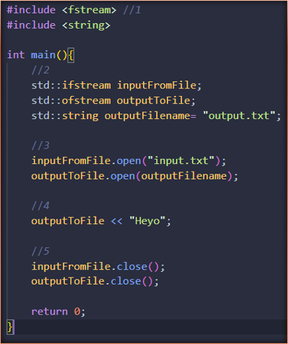
File I/O Recap (fstream)
First you need to include the fstream (file stream) library in the header "#include <fstream>"​
Define the fstream variable of choice. ifstream for input file stream, ofstream for output file stream and fstream can do both​
Then use .open(filename) to open the correct file for usage​
Input and Output with the carrots like normal cpp std::in std::out​
<< for output to file and >> for input from file​
Its generally good practice to close the file after usage​

Slide 4
File I/O (Using "ArgumentManager.h")​
What is Argument Manager?​
A program that takes in command line arguments and returns values based on it​
File which contains a class that can extract the useful information out of the arguments
What does this mean?​
The argument manager received from the TAs splice arguments given at run time to easily execute a script to auto grade code​
Check Teams for “Tutorial” PDF

Slide 5
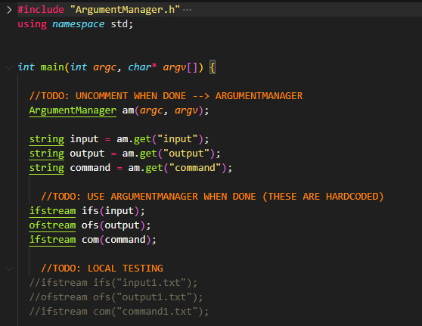
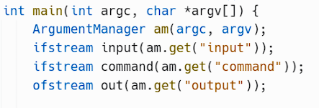
Testing w/ ArgumentManager for Assignments
Make sure to have:
#include "ArgumentManager.h"
#include <fstream>
When submitting assignments in the server, your code must be setup this way or you will not receive the correct grade.
When testing different cases locally (on your IDE) though, do the following
OR

Slide 6
Server and Argument Manager​
On Dr. Rizk's website, there are resources such as a PowerPoint and even a video on how to use the Linux server.​
We won’t cover the specifics of ArgumentManager due to the provided resources. However, if you have further questions after watching/reading about using the Linux server or ArgumentManager, feel free to contact us or the TAs​
https://rizk.netlify.app/courses/cosc2430spring/2_resources/​

Slide 7
PuTTY/Terminal Sign In
PuTTY:
Host Name: 2436.cs.uh.edu
Port: 22
Connection Type: SSH
Username: Canvas
Password: PSID + First Initial Capital + Last Initial Capital
Terminal (Mac):
Login: “ssh cosc###@2436.cs.uh.edu”
Password: PSID + First Initial Capital + Last Initial Capital
FileZilla:
Same as PuTTY Login Info

Slide 8
PuTTY/Terminal Commands
Basic commands for the PuTTY terminal:
mkdir “folder name” - make a folder
rm -r “folder name” - remove a folder
rm “file name” - remove a file
ls - List of all the files in that folder
cd “folder name” - Used to Enter a specific file in that folder
cd .. - Used this to exit out of the folder you are currently in
cat “filename” - see all contents in a file
chmod u+x test.sh - give you permission to run the test file (this might be different or similar depending on what Rizk said in class)
./test.sh - runs the test file to test your code
Compiling: g++ -std=c++11 –o /*ProgramName*/.cpp​

Slide 9
General Server Workflow
Use FileZilla to upload your HW’s/Labs/PA’s to the server (be sure to correctly name folders, they’re case sensitive)
Be sure to include all the right files
main.cpp + .h and other .cpp files
input.txt cases (and command.txt if had)
ans.txt cases
ArgumentManager.h
test.sh
After files have been uploaded, go to PuTTY or Mac Terminal and log into server
cd into correct assignment and run test.sh to check if you pass/fail the given test cases (may need to run chmod command to get permission to run test.sh files)

Slide 10
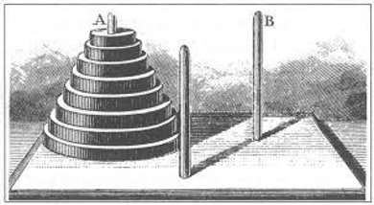
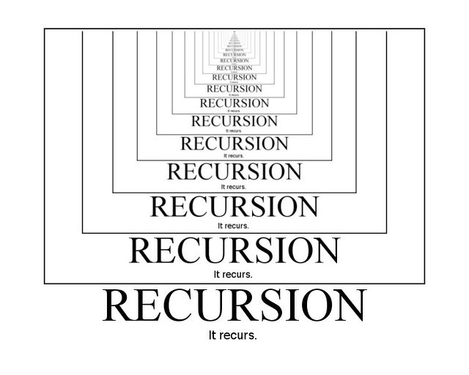
Recursion

Slide 11
Recursion
Recursion is a technique that allows us to break down a problem into one or more subproblems that are similar in form to the original problem.​ Occurs when a thing is defined in terms of itself or of its type​.
A function that calls itself is known as a recursive function
Musts for recursion:​
Code must have a case for all valid inputs
Need a condition to stop
This is what we call a “base” case, without them, our recursive function would call itself and get stuck in an infinite loop
Repetition. It must be a recurring process as you are calling the same exact function again​
Each time you make a recursive call, it should be to a simpler instance of the same problem, making progress towards the “base” case

Slide 12
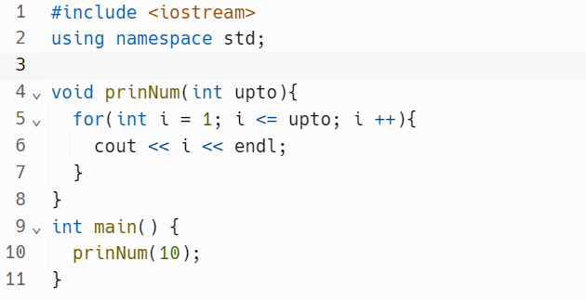
Quick Practice
Let's say that we wanted to print the numbers from 1 to 10.
How would you do it recursively?
Iterative
Approach →

Slide 13
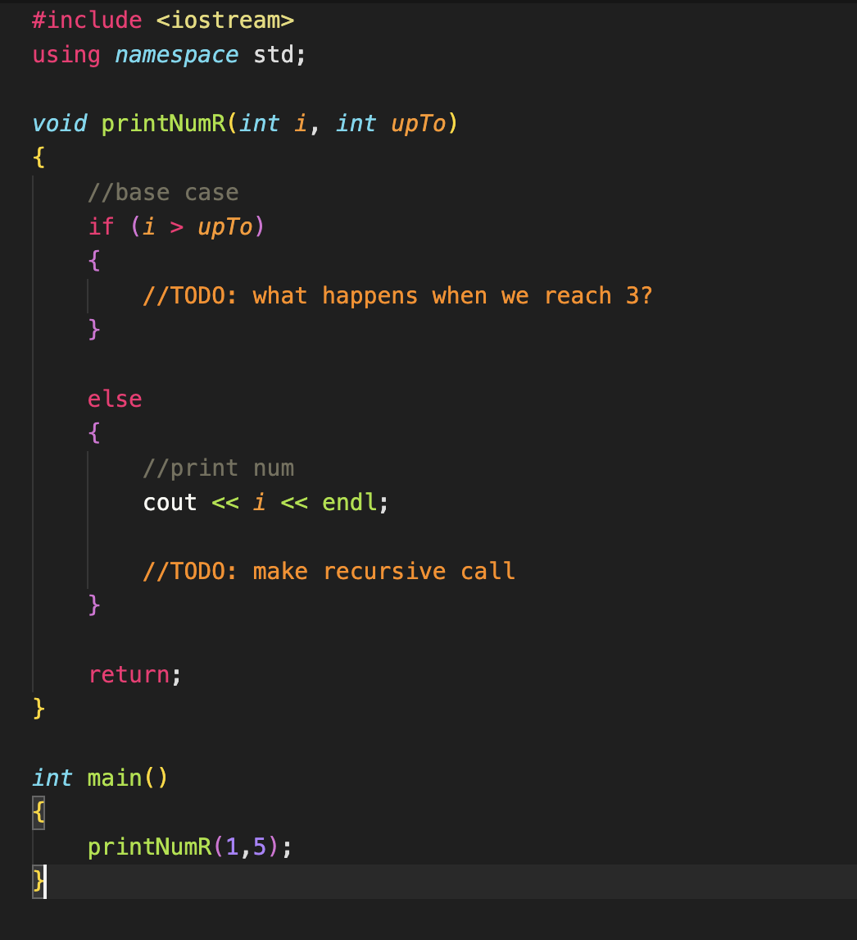
Sample Code

Slide 14
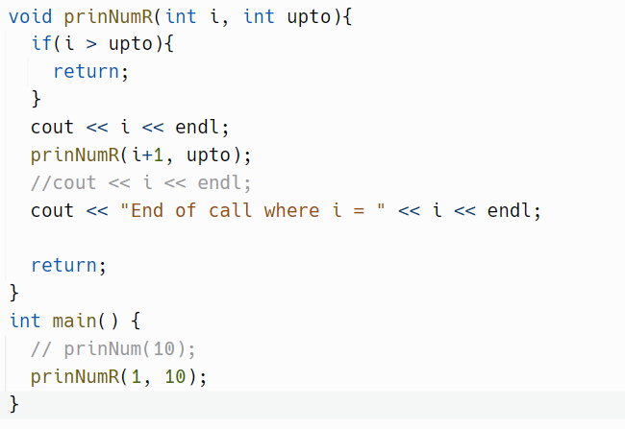
Solution
To see what actually prints out:
Uncomment cout after prinNumR call

Slide 15
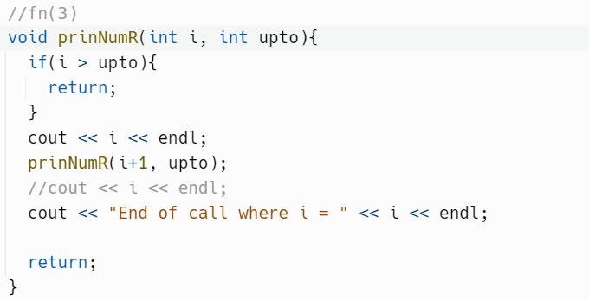
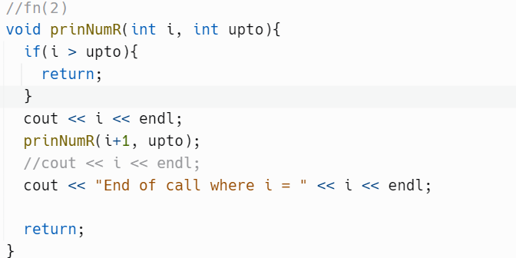
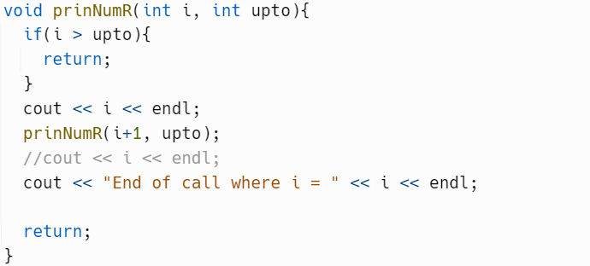
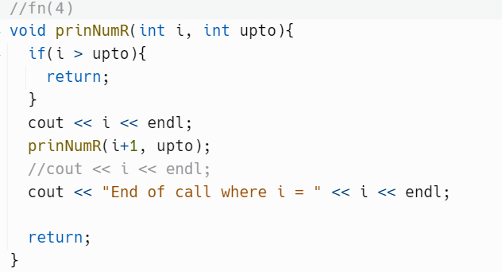
What actually happens
Output console:
1
2
3
Recursion happens in a stack
Let says we want to print 1 to 3
RETURN

Slide 16
Why Recursion?
We usually think of iterative and recursive approaches when it comes to certain problems, but is recursion always better?
Let’s take a look at the Fibonacci Sequence…

Slide 17

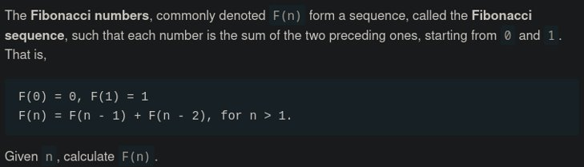
Fibonacci Sequence​

Slide 18
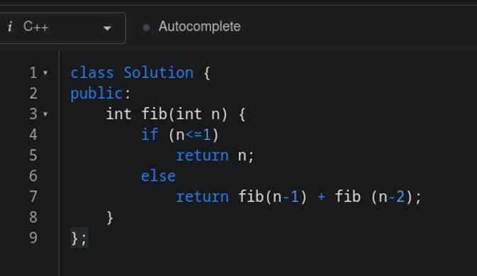
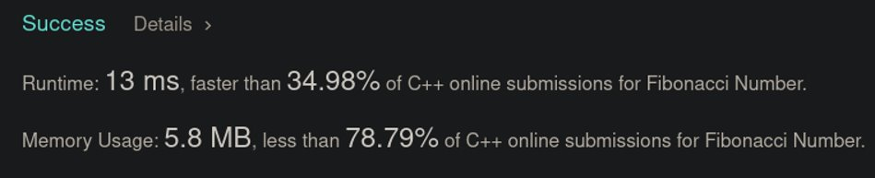
Recursive Approach

Slide 19
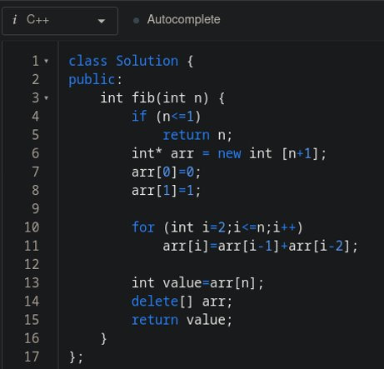
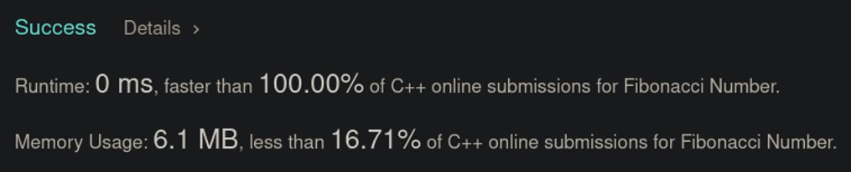
Iterative Approach

Slide 20
So… why recursion?...
Recursion can only be used in a function while iteration can be used mid-code and in a function
Recursion has more overhead
Why would we use recursion over iteration???

Slide 21
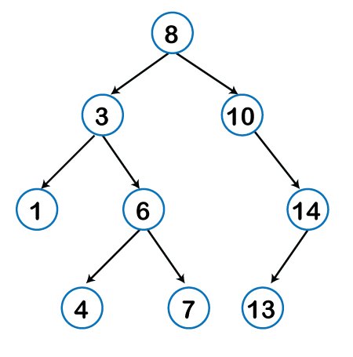
It Makes Our Lives Easier!
It’s a way of breaking down a complex problem into more smaller building blocks
Everything can be done iteratively; however, (you will see this when you get to trees) sometimes it's easier to write it recursively rather than iteratively due to the complexity required to iteratively implement the code

Slide 22
Your Turn: Factorial
You will write a code that returns the factorial of a given number input using recursion.​
You may work with those around you for this problem​
The problem may be coded in an IDE of choice.​
If you do not have an IDE setup, then consider Replit​
Input: 3
Output: 6
Input: 5
Output: 120

Slide 23
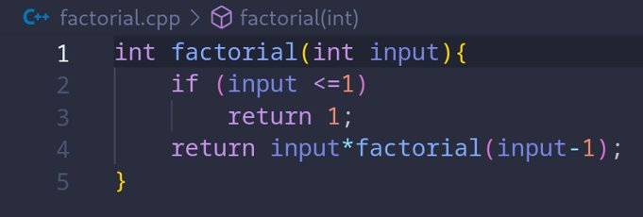
Solution
Once you turn in please take look

Slide 24

Office Hours
Please fill this form out and let us know when is the suitable time to hold office hours.

